Slide 1



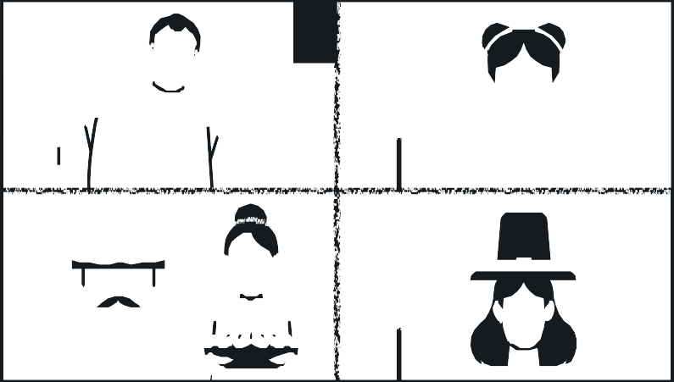



MoM
Generator
By Lego Coders
Vibha
Mayuri
Parth
Shivam
Sougata

Slide 2


Problem Statement & Solutions
Agenda
1
2
Automation Overview
3
Features and Benefits
4
Demonstration
5
Architecture and Technical Overview
6
Future Enhancement
7
Q&A

Slide 3

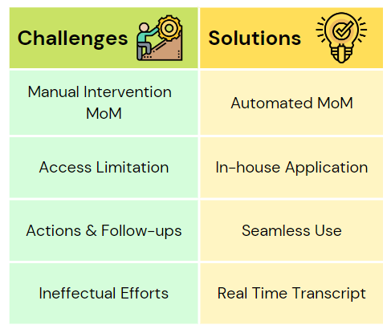








Problem Statement & Solutions

Slide 4




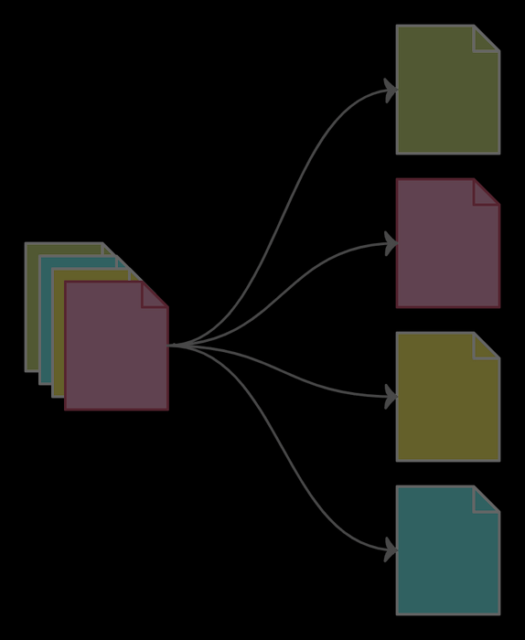


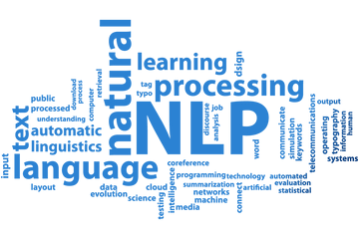

Automation Overview
Text Conversion
Speech Recognition
Real Time Data Transcripts MoM Conversion and Summarization
Email Notification to Intended Users
Text summarization
Notify Audience

Slide 5
Features and Benefits
FEATURES
BENEFITS
Transcribes speech in real time of all meeting participants
Real-time action items and feedback captured
Standard MoM template containing meeting time, participant names, discussion summary, queries & action items
User friendly UI
Download and trigger email notification to intended users
Seamless meeting minutes access to all team members
Real-time recognition, summarization and visualization capabilities
Seamless meeting process
Improve meeting participants productivity
Scalable to integrate with other applications such as Teams, Rocket chat, Skype

Slide 6
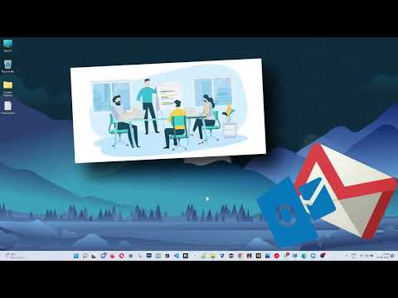
Demonstration

Slide 7
ARCHITECTURE AND TECHNICAL OVERVIEW
Azure Server
Gmail
Flask
Zoom
Transcript file
Python
NLP Libraries
DEPLOYMENT PIPELINE

Slide 8



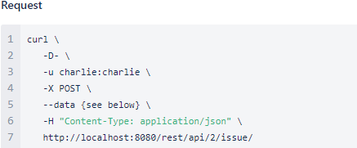
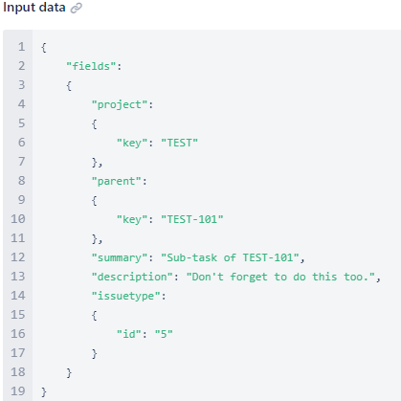



Future Enhancement
Creating a sub-task
Integrate with Rocket Chat, MS Teams channel, Skype
1. Integration with support Teams
Start transcription in Settings after enabled by admin
Reference Link
2 Integration with Rocket Chat
Transcript APIs are also available.Reference Link
3. Integration with Skype Lync
Recording and Upload media file for transcript options are also available. Reference Link
Create JIRA entries based on Action item
APIs are available to create JIRA tickets in ATLASSIAN product | Reference Link

Slide 9






Any Questions ?
Thank You !

